Slide 1

Smart Retail Store with Frictionless Checkout

Slide 2

The Retail Evolution Challenge
Industry 4.0 Meets Retail
Traditional barcode-based checkout systems are struggling to keep pace with modern retail demands. The sequential scanning process creates bottlenecks that frustrate customers and limit operational efficiency.
Key Pain Points:
Long queues during peak hours
Transaction time scales with item count
Human dependency introduces errors
Limited scalability options

Slide 3





Breaking Down the Bottleneck
Sequential Scanning
Each product scanned individually increases transaction time
Time Complexity
Transaction Time ∝ Number of Items creates linear delays
Error Prone
Double scans, missed items, and manual entry mistakes
Physical Dependency
Requires visible barcode labels on all products

Slide 4
Our Vision: Intelligent Automation
01
02
03
Vision-Based Detection
Parallel Processing
Automated Counting
YOLOv11 Nano identifies products instantly
Multiple items detected simultaneously
Frequency analysis calculates quantities
04
05
Smart Billing
Digital Receipt
Price lookup and total calculation
Structured, professional billing

Slide 5
Project Objectives
YOLOv11 Implementation
High Accuracy Targets
Product Counting
Billing Integration
Automate quantity calculation through detection frequency analysis
Deploy vision-based object detection for retail environments
Achieve exceptional precision and mAP scores for reliable billing
Connect AI detection with inventory pricing database
Receipt Generation
Modular Architecture
Create professional, structured digital receipts
Design scalable system for future enhancements

Slide 6







System Architecture Overview
Camera Input
Image capture of products
Preprocessing
Resizing and normalization
YOLOv11 Detection
Object identification
Product Counting
Quantity calculation
Price Lookup
Inventory database query
Bill Calculation
Total amount computation
Digital Receipt
Structured billing document

Slide 7
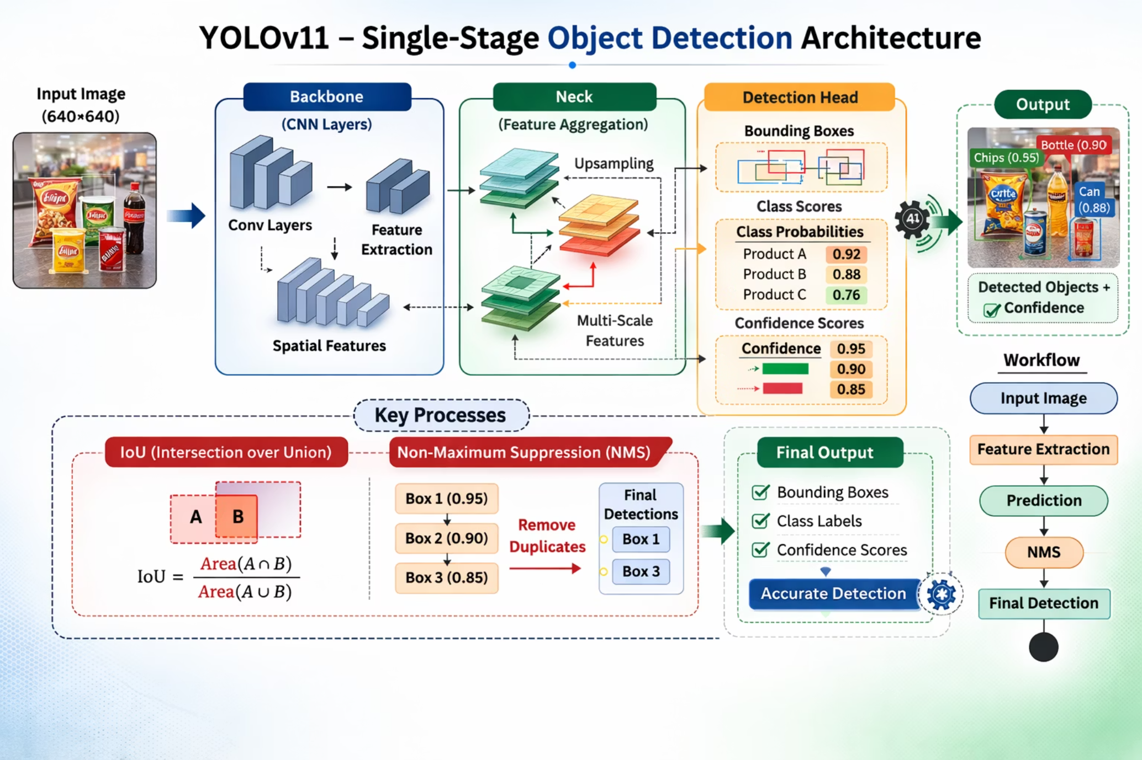
YOLOv11 Architecture Deep Dive
Single-Stage Detection
YOLOv11 processes images in a single pass, predicting bounding boxes, class probabilities, and confidence scores simultaneously.
Key Components:
Backbone: Feature extraction through CNN layers
Neck: Multi-scale feature aggregation
Detection Head: Bounding box, class, and confidence prediction
Uses IoU for localization accuracy and Non-Maximum Suppression (NMS) to eliminate duplicate detections.

Slide 8




Product Detection Pipeline
Image Resizing
Input scaled to 640×640 pixels for consistent processing
Feature Extraction
CNN layers identify relevant product characteristics
Prediction Generation
Model outputs bounding boxes, class labels, and confidence scores
Confidence Filtering
Low-probability detections removed for accuracy
NMS Processing
Overlapping boxes eliminated, keeping highest confidence
Final Output
Clean list of detected products with quantities

Slide 9
Intelligent Billing Engine
Automated Product Counting
Digital Receipt Generation
Detected product names are aggregated and analyzed using frequency distribution to calculate quantities automatically.
Professional billing document includes store details, transaction ID, timestamp (IST), itemized list with quantities and prices, and total amount.
Inventory Database
Billing Formula
Product names mapped to unit prices
Total = Σ (Price × Quantity)

Slide 10
Results & Future Roadmap
93%
86%
88%
80%
Precision
Recall
mAP@50
mAP@50-95
Accurate product identification
Products successfully detected
Mean average precision
Robust performance
Future Enhancements
Real-time webcam integration for live detection
GST calculation module for compliance
PDF receipt generation for documentation
Payment gateway integration for complete checkout
Cloud-based database for scalability
Customer behavior analytics for insights

Slide 11
Training Configuration
Model Used: YOLOv11 Nano
Epochs: 10
Batch Size: 16
Image Size: 640×640
Loss Components:
Classification Loss
Localization Loss
Objectness Loss
Model trained in Google Colab with GPU support.

Slide 12
Performance Results
Metric
Value
Precision
0.93
Recall
0.86
mAP@50
0.882
mAP@50–95
0.798
High precision ensures billing reliability.
Strong mAP confirms accurate localization.

Slide 13
Comparison: Existing vs Proposed System
Feature
Barcode System
Proposed System
Processing
Sequential
Parallel
Human Dependency
High
Low
Speed
Increases with items
Near constant
Scalability
Physical expansion
Computational
Automation
Limited
Intelligent
The proposed system significantly improves efficiency.

Slide 14
Advantages & Limitations
Advantages:
Eliminates barcode scanning
Faster checkout process
Reduces human error
Modular & scalable design
Industry 4.0 aligned
Limitations:
Requires properly labeled dataset
Sensitive to extreme lighting
Currently static-image based

Slide 15
Conclusion & Future Scope
Conclusion
Successfully developed AI-based frictionless checkout prototype
Integrated detection, counting, billing, and receipt generation
Achieved high detection accuracy
Demonstrated feasibility of AI in retail automation
Future Enhancements
Real-time webcam integration
GST calculation module
PDF receipt generation
Payment gateway integration
Cloud-based database
Customer behavior analytics

